Slide 1

SNAKE PRONE ZONE - 2

Slide 2
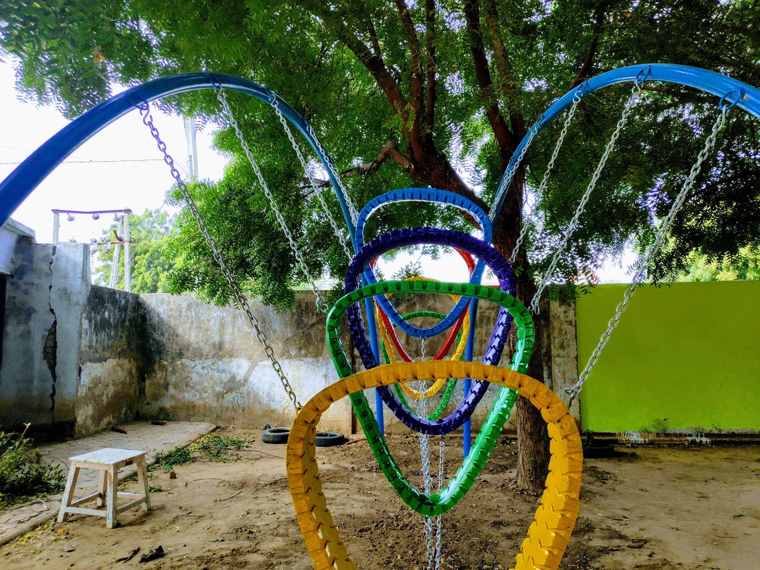
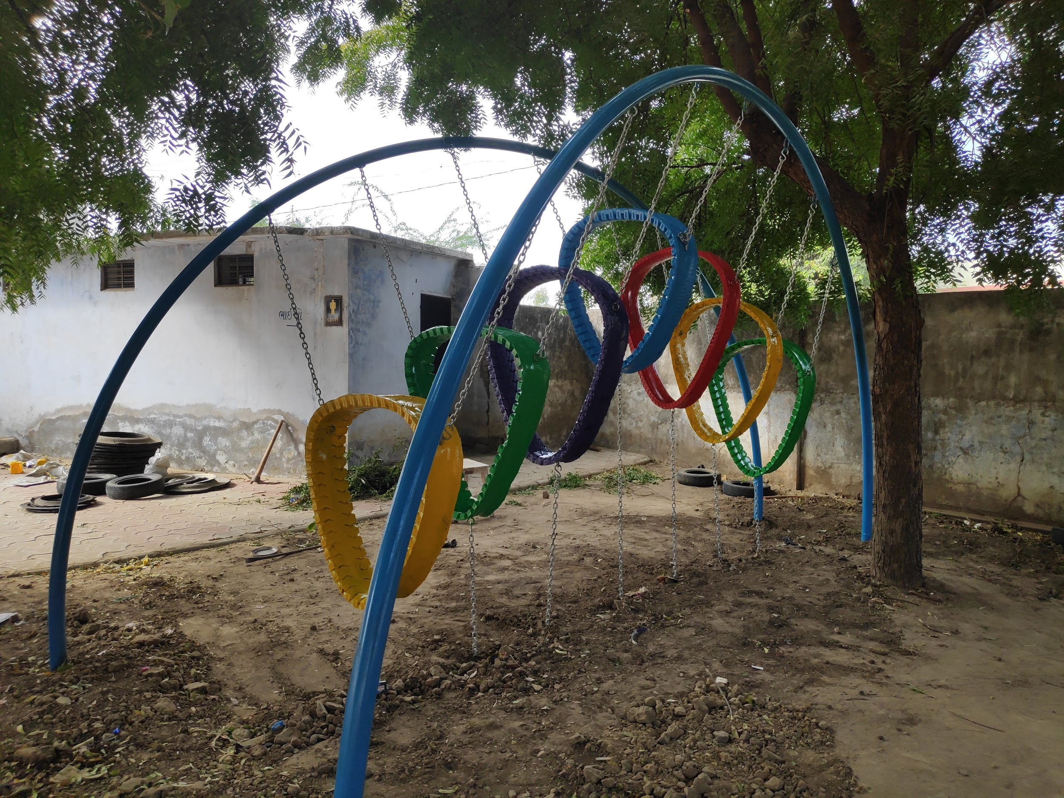
ADVENTUROUS HEAVING HOOPS
The kids crawl through the tyres and the challenge is to pass through each loop. This is again a fun element, helping them increase their coordination.
We could install this with layers of truck tyres which are strong and are resistant to wear and tear, supported by metal frames anchored to the ground.
Note : The following image explains the idea of the element and the following element, will be detailed out such that, there would be no settling corners for snakes.

Slide 3
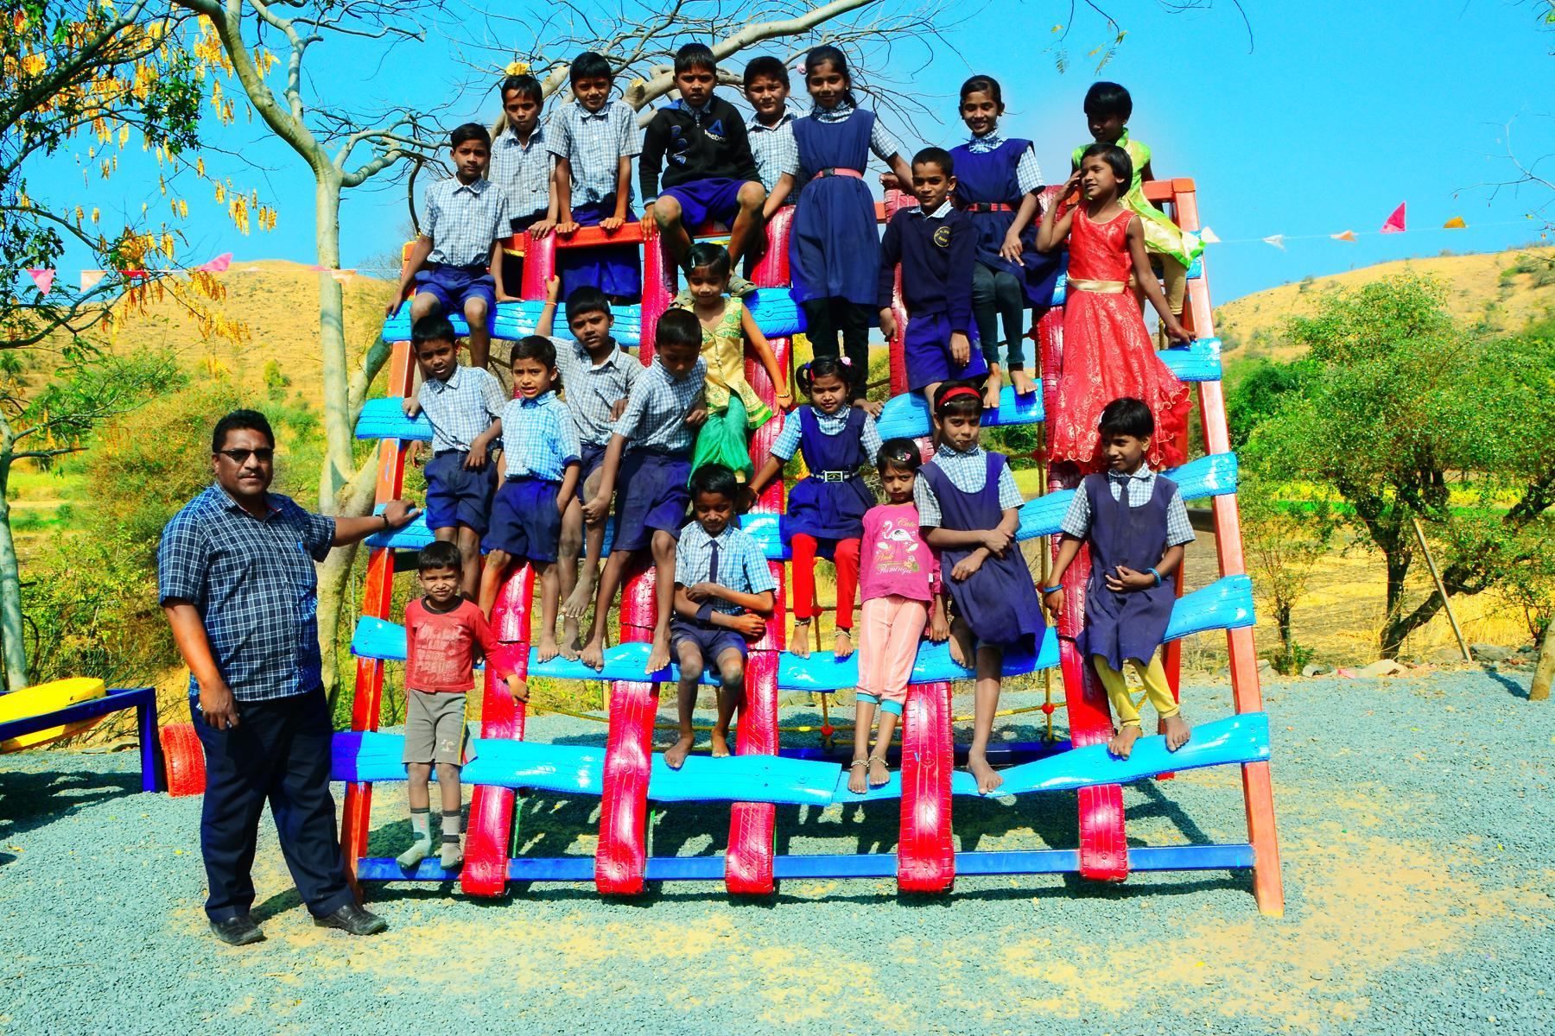
TYRE CLIMBER
A climber is an element which would help them coordinate better and achieve targets. This would enrich their body and mind coordination.
note : The following image explains the idea of the element and the following element, will be detailed out such that, there would be no settling corners for snakes.

Slide 4
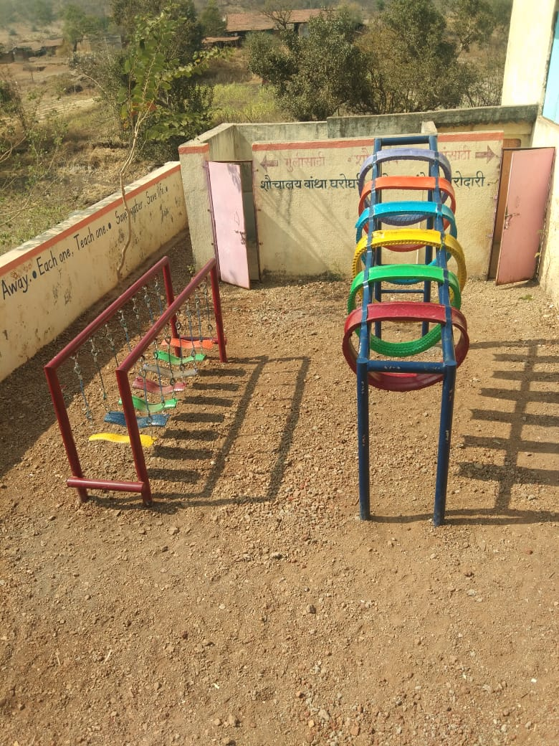
SWINGING BRIDGE
note : The following image explains the idea of the element and the following element, will be detailed out such that, there would be no settling corners for snakes.

Slide 5
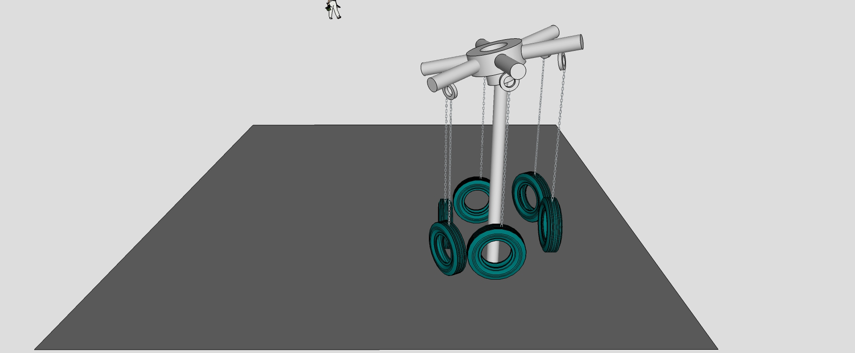
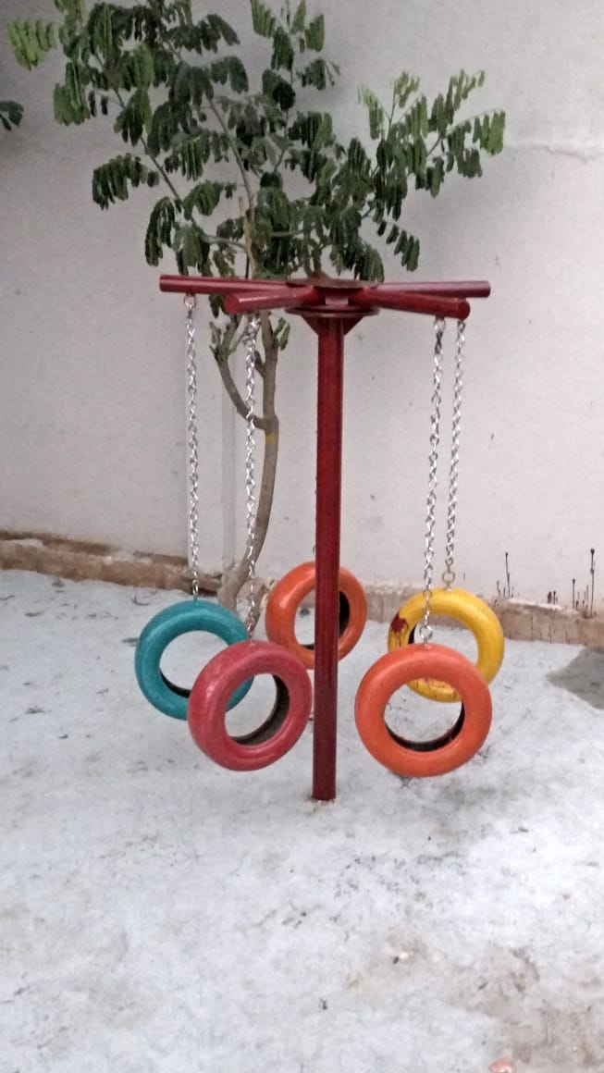
MERRY A ROUND
A revolving setup which would otherwise function as individual swings. This a dynamic element which will help them balance with the speed and hold on. It would be amusing for children of all age group.
note : The following image explains the idea of the element and the following element, will be further detailed out to fit site context.

Slide 6
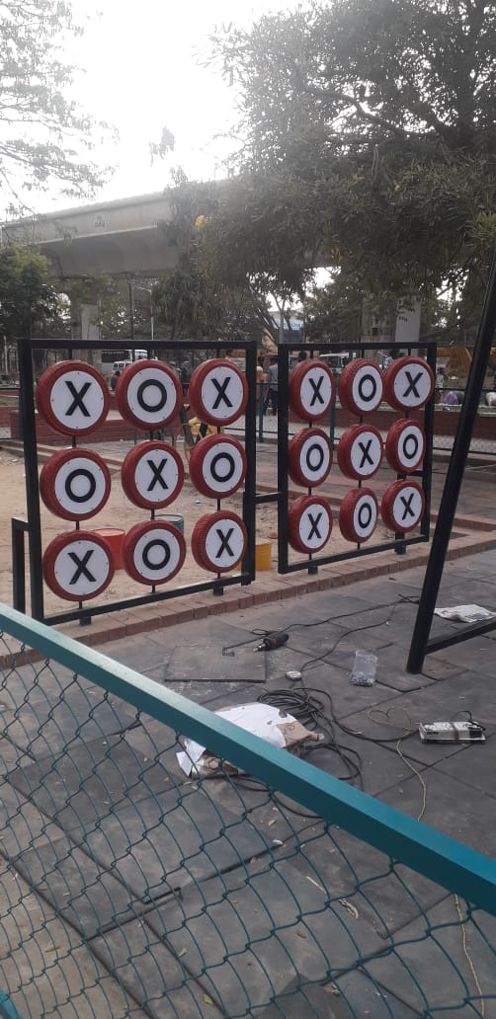
TIC TAC TOE
two players, X and O, who take turns marking the spaces in a 3×3 grid. The player who succeeds in placing three of their marks in a horizontal, vertical, or diagonal row wins the game. It's a strategy game. The life scale tic tac toe would be fun to perceive.
scooter tyres : 09
note : The following image explains the idea of the element and the following element, will be detailed out such that, there would be no settling corners for snakes.

Slide 7
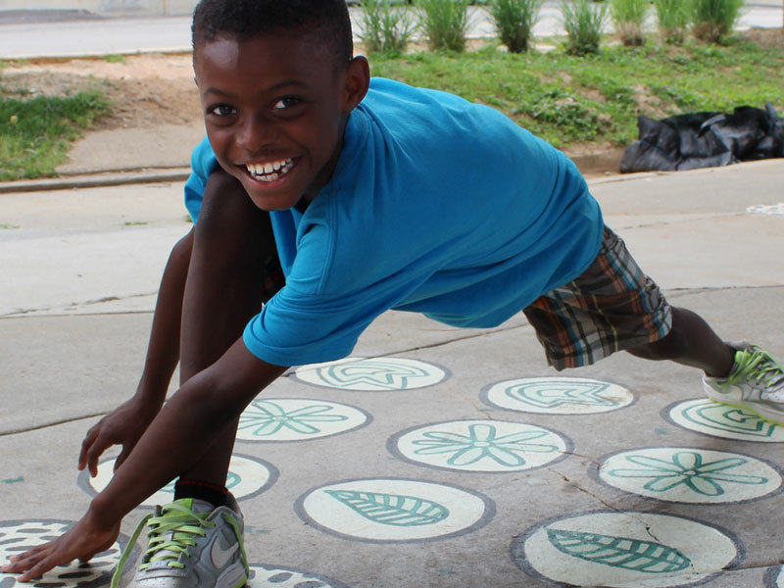
LET’S STRETCH
note : The following image explains the idea of the element and the following element, will be detailed out such that, there would be no settling corners for snakes.

